Slide 1

Hey, George!
POC introduction
27.7.2023

Slide 2
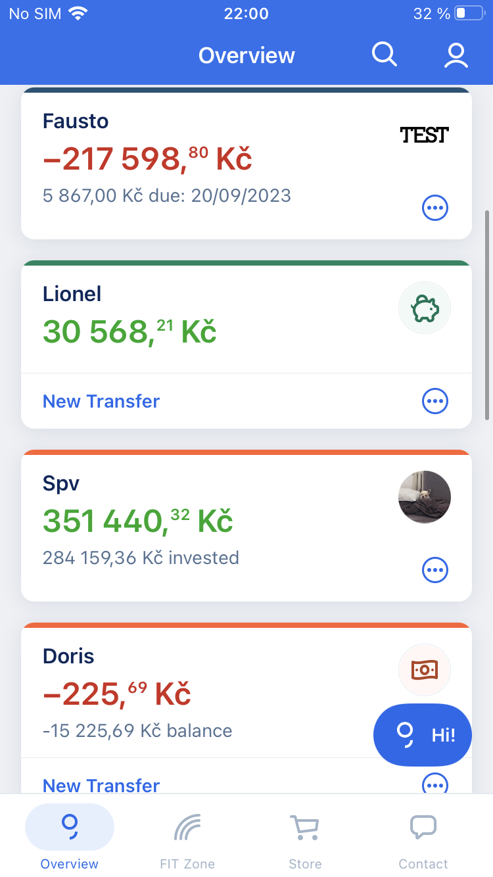
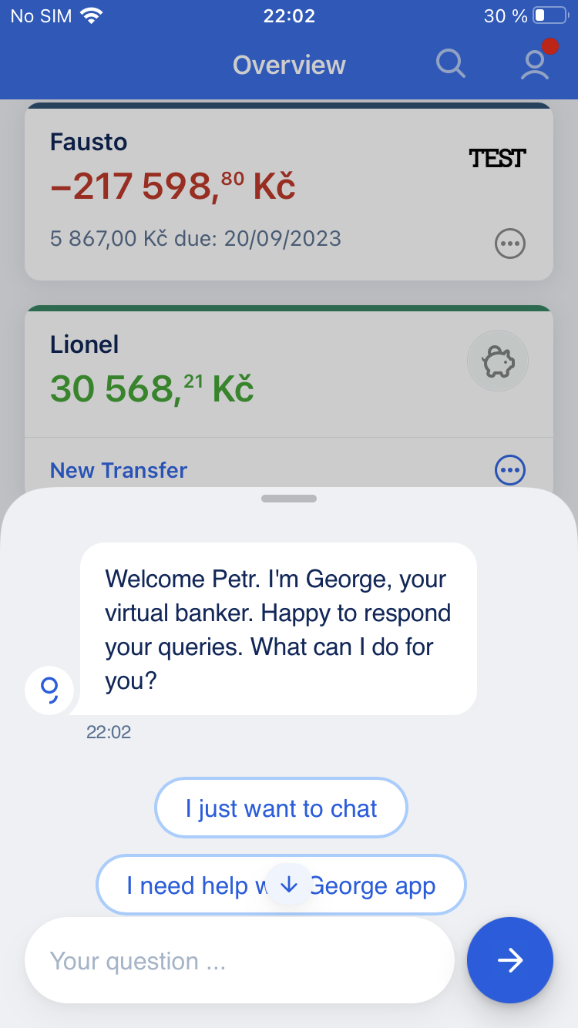
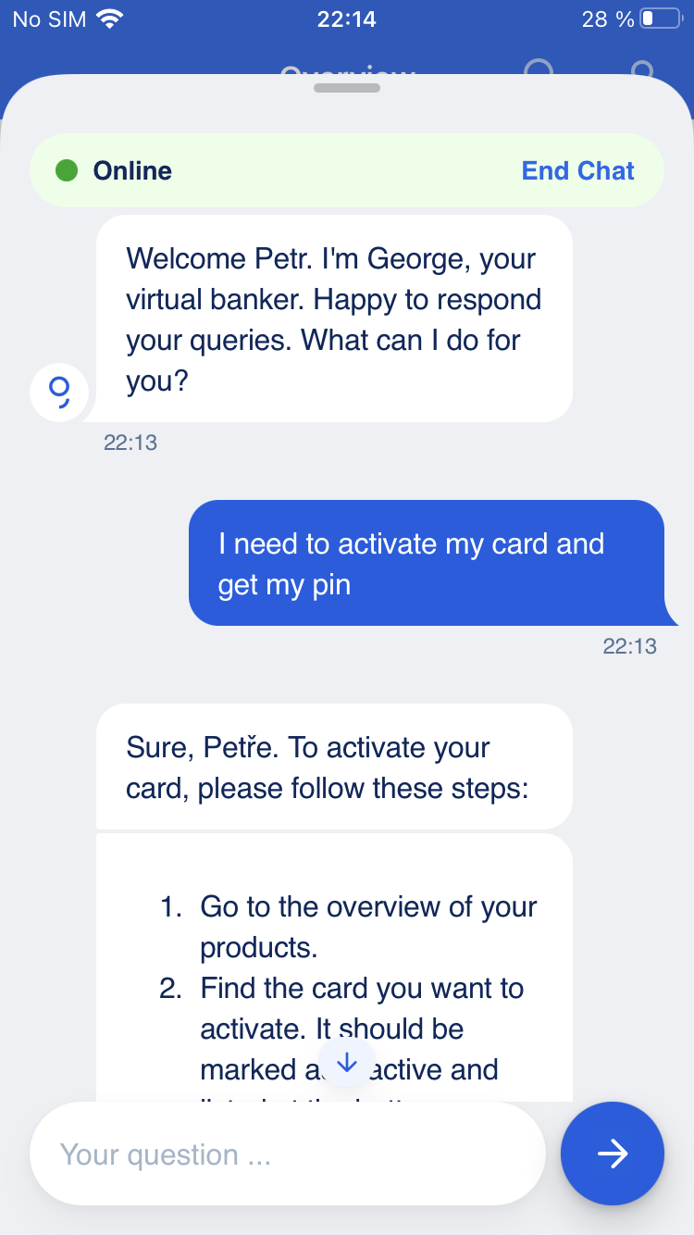
Hey George! is new AI driven conversational platform Real usecase example
Chat is on Overview screen
Opening in the midsized window. Client can decide if wants to continue
Client can use conversational interface for Feature search

Slide 3


Hey George! is new AI driven conversational platform providing unified experience between an ecosystem of Chatbots
High-level architecture
1
Masterbot
Handover local bot back to Masterbot
Handover Masterbot to specific bot
1
Feature bot
1
Chitchat
1
Other centrally managed bots
2
Mortgage bot
2
Insurance bot
2
Other locally managed bots
3
Service center chat
Handover local bot to human support
1
2
3
Central bots & “Masterbot”
Local chatbots
Human support
Features
Masterbot as orchestration layer to correctly route client conversation
Chatbot knows the client identity
General chit-chatting functionality
George Feature search
Human handover support
Handles local scenarios and support cases
Handover from other bots (reactive/ question based)
Triggered by use cases where solution requires human intervention or user is not satisfied with chatbot solution
Solution
Provided & maintained by the central George team
Driven by ChatGPT models and IBM Watson
Provided & maintained by local banks
Can be running on any AI technology
Chat is handed over from master bot with the chat history
Run & maintained by local banks
Can be running on any CC technology

Slide 4


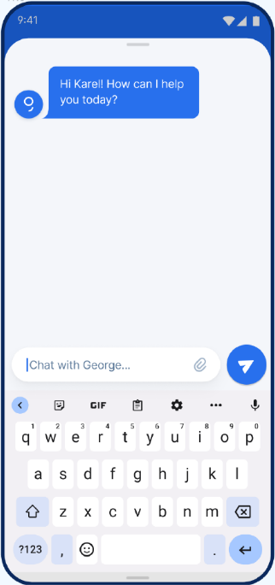







Hey, George! Implementation in CSAS What we have achieved
First Phase Realization
Architecture (for CSAS)
In less then 4 months timeframe we have:
Integrated ChatGPT API, Embeddings in Chat platform
Got all the security approvals for POC rollout
Implemented business features
2nd August the POC will be deployed to PROD
16th August to be available for Hey, George! users
Legend
AS-IS components provided by local country
AS-IS components provided by George chat team
New components provided by George chat team
IBM Watson
Watson adapter
CSAS
Genesys
Call center adapter
Messaging Framework
CSAS
CSAS
IBM Watson
ED
Watson adapter
CHAT UI Client George App Webview
ED
Azure OpenAI
OAI adapter
ED
PROMPT ENGINEERING
EMBEDDINGS (vector search)
FINE-TUNING

Slide 5

Hey, George! PoC Scope Scope of Increment 1
Delivered scope Increment 1 (BOM 23.26)
Hey, George! integrated in George App
Welcome message with salutation
Routing to the local bot
Feature search by chat conversation for clients’ products​
Smart chitchat
Slide 2
Slide 6
Slide 6
Slide 7
Slide 8

Slide 6


Hey, George! PoC Master bot Detailed description
Business Features
Architecture
Displaying the welcome message with salutation
Perform decision which skill to answer your query
Retrieve the client products
Feature search skill will route you to the Local bot or CSP when it decides it is reasonable (through Master bot)
Client query
Master bot
Chitchat bot
Feature search bot
Challenges
Recognition of the client topics
Difficult to train specific topics by prompt engineering, better results achieved by fine-tuning of the custom OAI model (to be targeted in I2)
Local Chatbot
CSP Integration
Note: further rerouting between bots is fully supported
Definition of the responsibilities
It can be difficult to define which question should be routed to local bot and what to Feature search skill

Slide 7


Hey, George! PoC Feature search Detailed description
Business Features
Processing Flows
Only defined actions supported (base is the Feature search George feature)
Actions descriptions are used for training. Fine-tuning will be ongoing task.
Only actions available for client in George are answered. Other actions are redirected to the local bot
Client is provided with the guide how to use the feature and the deeplink when available. For the features where more instances are available, carousel is used.
Keeping context
1.
Embedding calculation
Embedding
Processing during startup or when the data are changed
2.
Client question processing
Client query
ADA-002 Vectorize
Challenges
Retrieved embeddings
GPT-4 Validation
Language constraints for training
Each query to be provided by the training context. Such trainings need to be done in specific language separately. The automatic translations are not working well.
Embeddings should be kept in the same language (source)
Client query
GPT-4
Conversation
Training data
Client conversation with GPT
Limited amount of deeplinks
Only approx. 20% of features have deeplink. All POs were requested to work on it. As the mitigation there can be added parent deeplink where it has sense.
<<Keeping context>>
Master bot
Result processing
Local bot
Gathering George features description
It is quite time-consuming gathering of the features description
Human handover

Slide 8
Hey, George! PoC Chitchat skill Detailed description
Smart chitchat skill
Smart chitchat flows
You can talk to chitchat in defined topics only
There are pretrained topics: Information about ČS, Erste, history of George and financial health
There are predefined and pretrained the topics which we want to support (subject to change):
When we don’t support the selected topic, we inform the client about it
1.
Embedding calculation
Embedding
Processing during startup or when the data are changed
Weather
Sports events
Entertainment
Animals and pets
Jokes and humor
Ecology and environment
Health and wellness
Nature and outdoor activities
And many others
2.
Client question processing
Client query
ADA-002 Vectorize
Retrieved embeddings
GPT-4 Validation
Challenges
Answering topics without detailed training
Most of the features in the Chitchat are opened. There is the risk the answers will not be acceptable.
Client query
GPT-4
Conversation
Training data
Answers are made up
When the GPT doesn’t know the answer, it is trying to use its own logic.
Client conversation with GPT
<<Keeping context>>
Using of embeddings needs care
Vector search is working precisely with cleared data and utterances, otherwise it is often selecting the training data which are not correct
Master bot
Result processing
Human handover

Slide 9
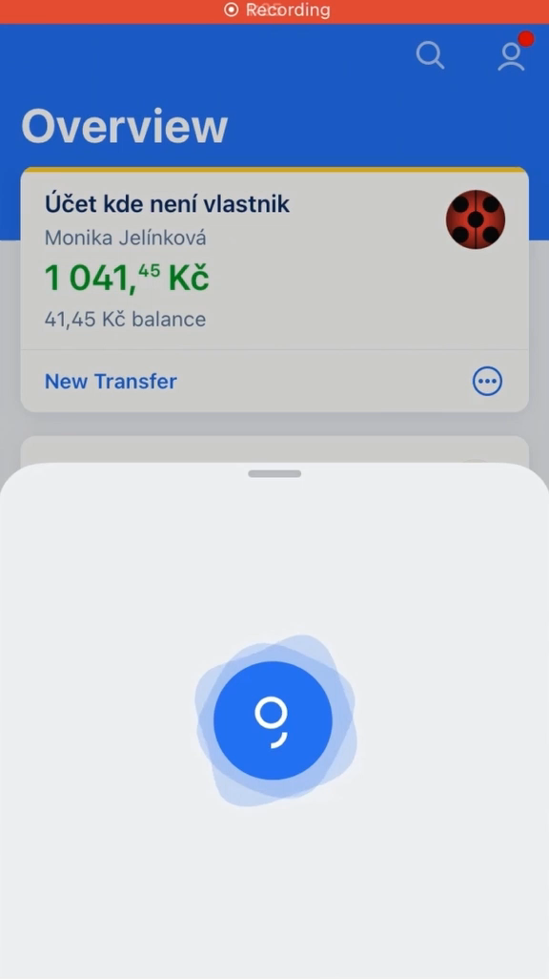
Hey, George! PoC Examples Video

Slide 10

Hey, George! PoC Scope Scope of Increment 2
What will come soon Increment 2
Optimization for speed (e.g. answers to be sent gradually)
Client can ask questions in English
Chat to be started from push notification (POC only)
Chat to be started proactively
Review of the POC results
George document search as part of Hey, George!

Slide 11

2024 Chatbot activities overview (proposal)
New Features (to be prioritized)
Team extension
Service & Support
Guidance for the George features
Support for cards in George
Support for payments and transactions
Product recommendation for improved client experience
Advise & General
Increase awareness about financial health
Upsell scenarios for client available store offers
Support when travelling abroad
Enhance budgeting skills
Help to build a reserve
Create financial healthy habits
Developer
Conversation / LLM Specialist 1
Conversation / LLM Specialist 2
1 FTE
1 FTE
1 FTE
Main responsibilities
Developing of the Central chatbot
Rollout of the Central chatbot to local countries
Maintenance of the Central chatbot
Support of the countries with the integration to the Central chatbot
Providing governance and support to building of the chatbot capabilities
Governance & Maintenance
Rollout of the central chatbot for all countries
Production conversations review and maintenance (low satisfaction, selected conversations, human handover)
Reporting
This year is covered from costs perspective. Budget for next year to be planned.

